Slide 1


Bagging – Random Forest – Boosting
Bagging – Random Forest – Boosting
Assembly techniques for predictive analysis

Slide 2
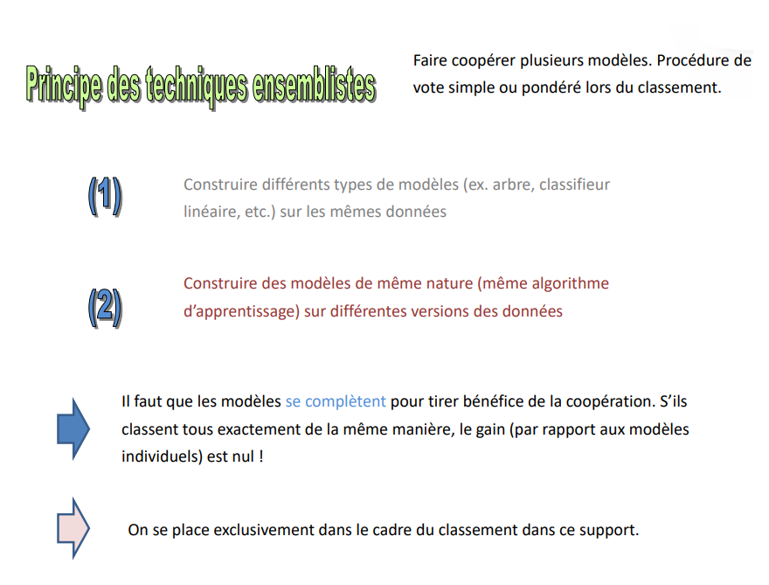
principle of set techniques
Bagging – Random Forest – Boosting
Cooperate several models. Procedure of simple or weighted vote when ranking.
Build different types of models (e.g., tree, linear classifier, etc.) on the same linear classifier, etc.) on the same data
Build models of the same nature (same learning algorithm) learning algorithm) on different versions of the data
The models must complement each other to benefit from cooperation. If they all rank exactly the same, the gain (compared to the individual models) is zero!
We place ourselves exclusively in the framework of the classification in this support.

Slide 3
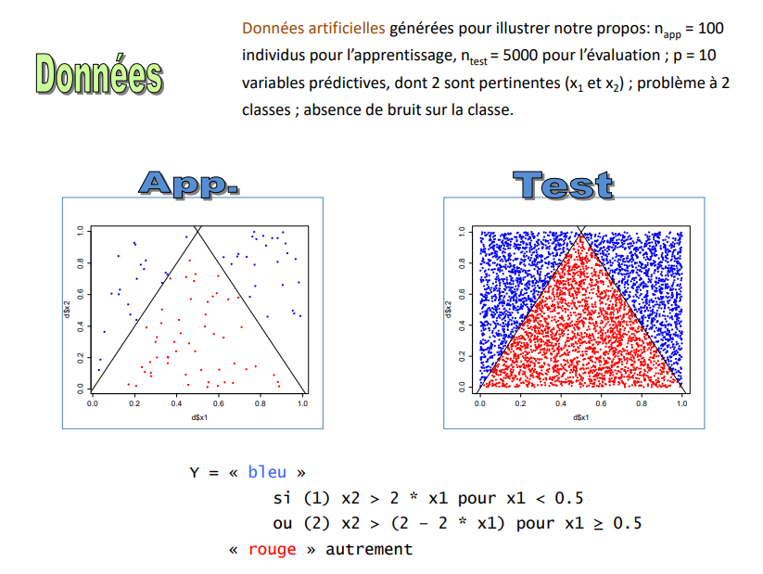
Data
Bagging – Random Forest – Boosting
Artificial data generated to illustrate our point: napp = 100 individuals for learning, ntest = 5000 for evaluation; p = 10 predictor variables, of which 2 are relevant (x1 and x2 ); 2-class problem; no noise on the class.
Y = "blue”
if (1) x2 > 2 * x1 for x1 < 0.5
or (2) x2 > (2 - 2 * x1) for x1 ≥ 0.5
"red" otherwise

Slide 4
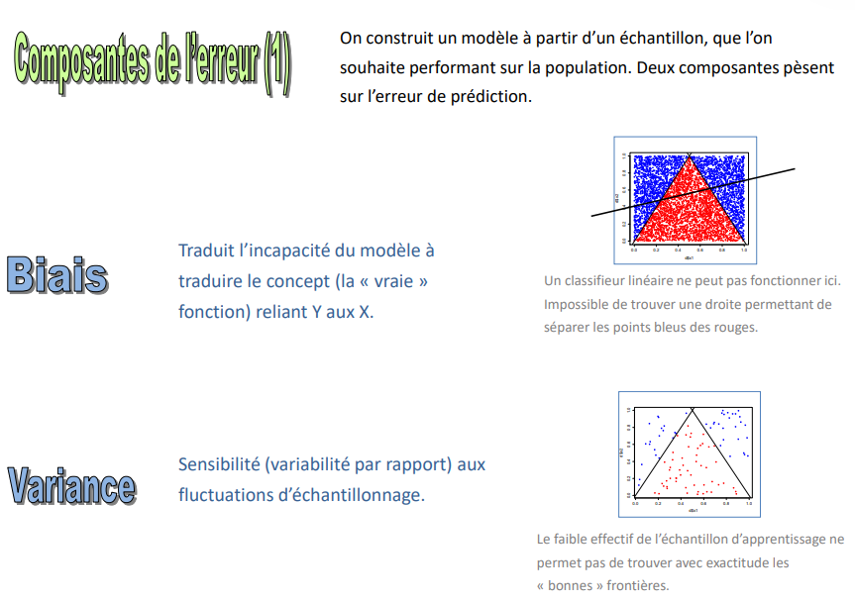
Components of the error (1)
Bagging – Random Forest – Boosting
We build a model from a sample, which we want to perform well on the population. on the population. Two components influence the prediction error.
Bias
Translates the inability of the model to translate the concept (the "real" function) function) linking Y to X.
A linear classifier cannot work here. Impossible to find a straight line allowing to to separate the blue points from the red ones.
Variance
Sensitivity (variability with respect to) sampling fluctuations.
The small size of the learning sample makes it impossible to sample does not allow us to accurately find the "right" boundaries. "good" boundaries

Slide 5
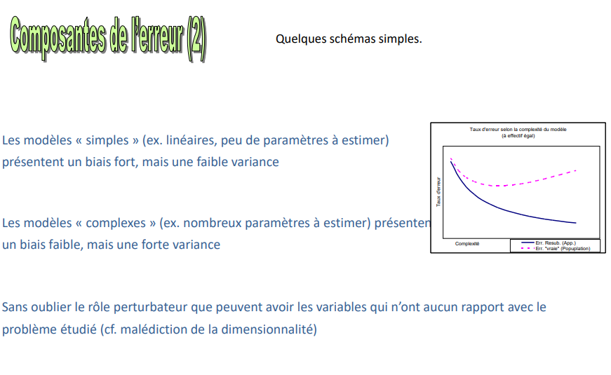
Components of the error (2)
Bagging – Random Forest – Boosting
Some simple diagrams
Simple" models (e.g., linear, few parameters to be estimated) have a strong bias, but a low variance
“Complex" models (e.g., many parameters to be estimated) have a low bias but a high low bias, but high variance
Not to mention the disruptive role that variables unrelated to the problem being studied can have (cf. curse of dimensionality)

Slide 6
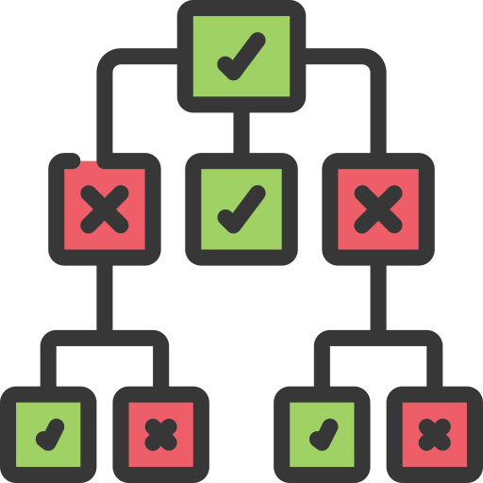
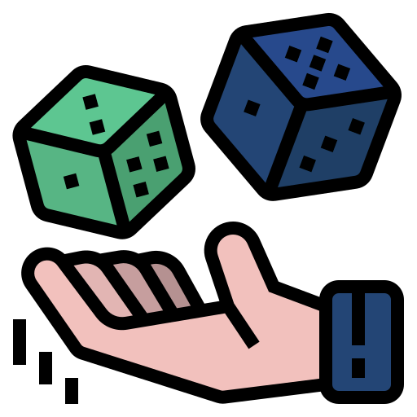
Decision trees
Decision trees
Originally were the decision trees

Slide 7
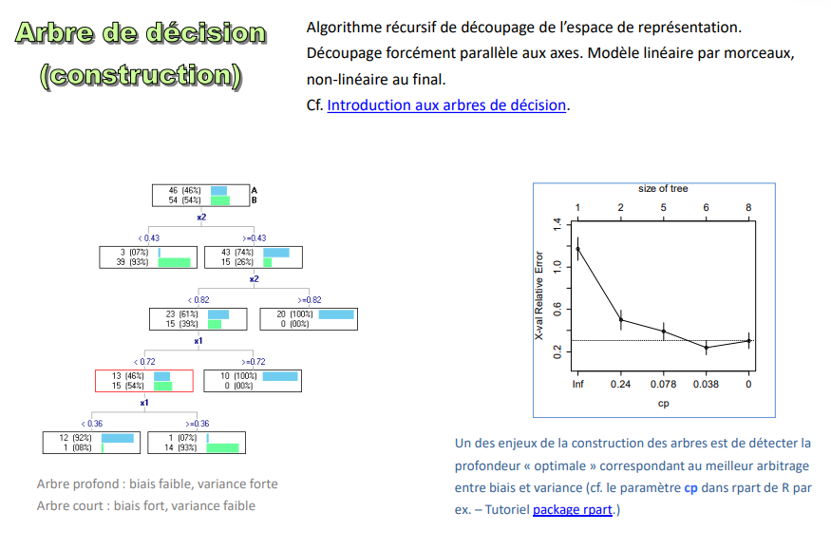
Decision trees (Construction)
Decision trees
Recursive algorithm for cutting the representation space. Cutting necessarily parallel to the axes. Linear model by pieces, non-linear at the end.
One of the challenges of tree construction is to detect the "optimal" depth optimal depth corresponding to the best trade-off between bias between bias and variance
Deep tree: low bias, high variance
Short tree: strong bias, low variance

Slide 8
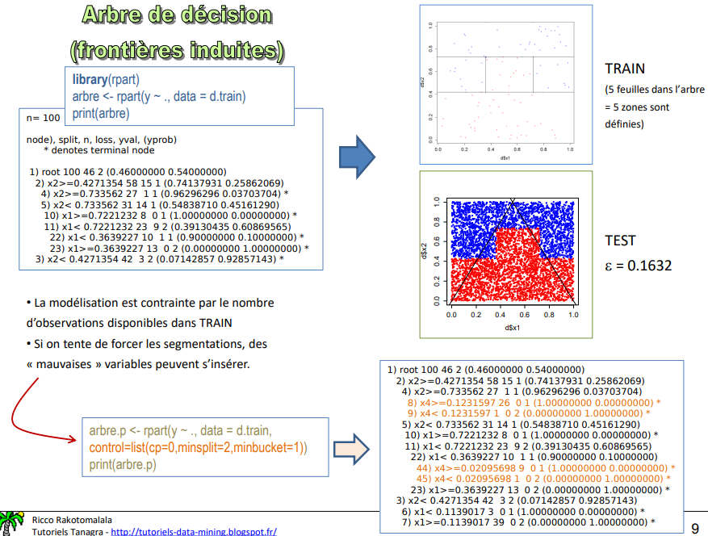
Decision trees (induced borders)
Decision trees
TRAIN
(5 leaves in the tree = 5 zones are defined)
TEST
ε = 0.1632
- The modelling is constrained by the number of observations available in TRAIN
- If we try to force the segmentations, "bad" variables can be inserted
"variables can be inserted
tree.p <- rpart(y ~ ., data = d.train,
control=list(cp=0,minsplit=2,minbucket=1))
print(tree.p)

Slide 9
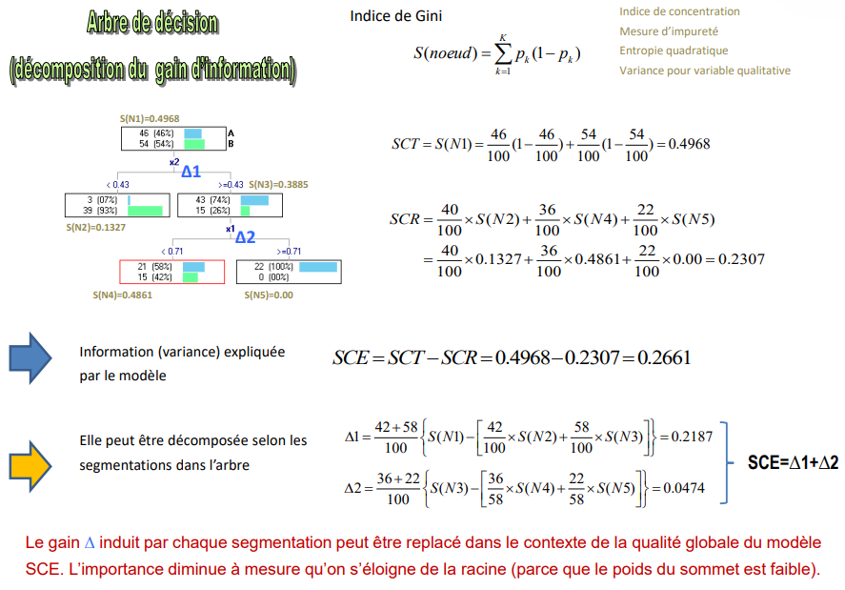
Decision trees (decomposition of the information gain)
Decision trees
Gini index
Concentration index
Impurity measurement
Quadratic entropy
Variance for qualitative variable
Information (variance) explained
by the model
It can be decomposed according to the segmentations in the tree
The gain ∆ induced by each segmentation can be put into the context of the overall quality of the model SCE. The importance decreases as one moves away from the root (because the vertex weight is low).

Slide 10
Report on decision trees
Decision trees
Advantages:
- intelligible" knowledge -- expert validation (if tree not too big)
- direct translation from the tree to a rule base
- automatic selection of relevant variables, robust to redundant variables
- non-parametric
- undifferentiated treatment of different types of predictor variables
- robust against outliers, solutions for missing data
- speed and ability to process very large databases
- enrich the interpretation of the rules with the help of unselected variables
- possibility for the practitioner to intervene in the construction of the tree
Disadvantages :
- stability problem on small databases (leaves with very small numbers)
- step-by-step" search: difficulty in finding certain interactions (e.g., xor)
- not well adapted to scoring
- fewer good performances in general compared to other methods (in reality, performances strongly dependent on the size of the learning base)

Slide 11
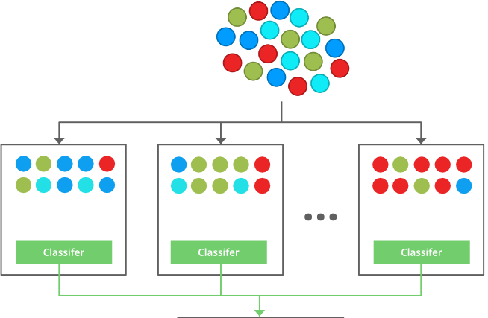
Bagging
Bagging
Agrégation de Boostrap (Breiman, 1996)

Slide 12
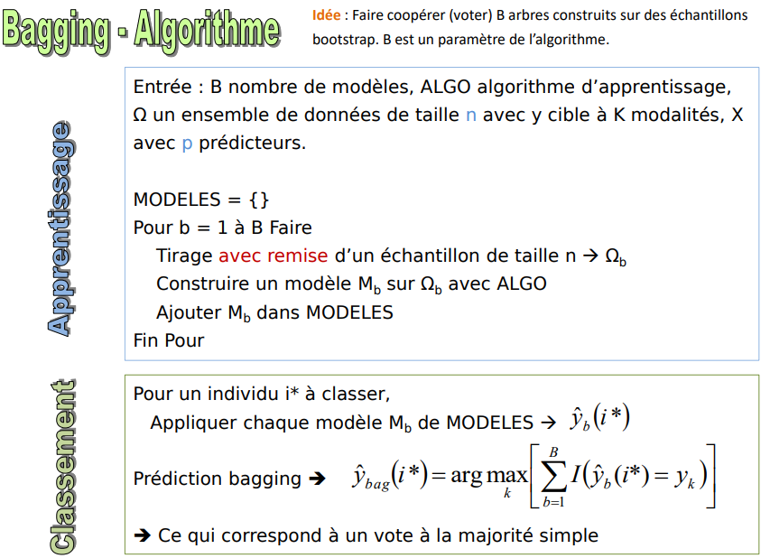
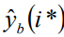
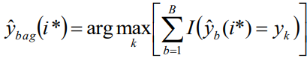
Bagging Algorithm
Bagging
Idea: To make cooperate (vote) B trees built on bootstrap. B is a parameter of the algorithm.
Input: B number of models, ALGO learning algorithm, Ω a data set of size n with y target with K modalities, X with p predictors.
MODELS = {}
For b = 1 to B Do
Draw a sample of size n → Ω b with a discount
Build a model Mb on Ω b with ALGO
Add Mb in MODELS
End For
learning
For an individual i* to be classified,
Apply each model Mb of MODELS →
Bagging prediction ➔
➔ This corresponds to a simple majority vote
Classification

Slide 13

Bagging Algorithm Why Does it work?
Bagging
Interest of cooperation. Making models cooperate is only interesting if the models do not all rank in the same way the same way (if the vote is systematically unanimous, it is better to have only one model).
Bias and variance. Bagging bias = bias of the underlying model. Bagging reduces above all the variance. It is necessary Therefore, the underlying models must have a low bias, capturing the complexity of the relations between y and the X.
Weak learners. Bagging does not take advantage of weak learners (weak classifier - see boosting). It The underlying models must be of good quality.
Overlearning (overfitting). Increasing B does not lead to overlearning. In practice, a hundred is enough, but it can be adjusted to the study.
Decision trees. Bagging can be applied to any type of model. But trees are particularly advantageous because we can reduce the individual bias by creating deep (unpruned) trees, the variance (individual of each tree) is then compensated by the mechanism of cooperation in ranking.

Slide 14
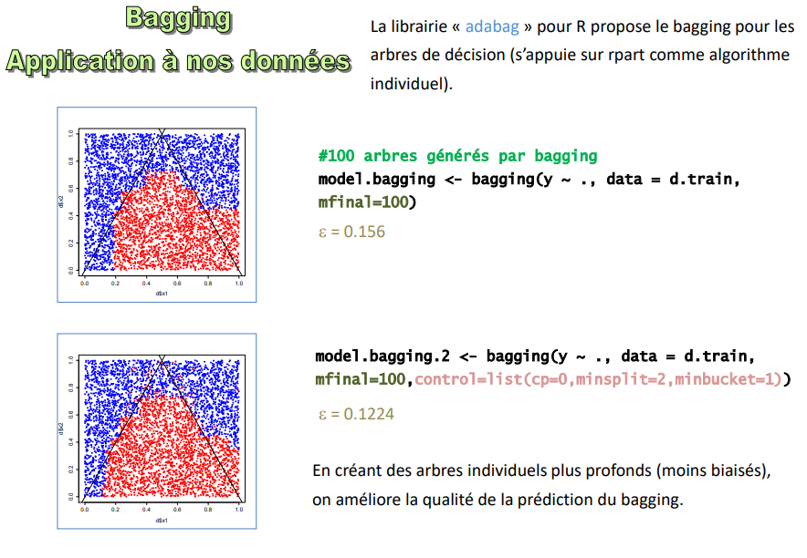
Bagging Algorithm Applying it to our Data
Bagging
The "adabag" library for R offers bagging for decision trees (based on rpart as an individual algorithm). algorithm).
#100 trees generated by bagging
model.bagging <- bagging(y ~ ., data = d.train, mfinal=100)
ε = 0.156
model.bagging.2 <- bagging(y ~ ., data = d.train,
mfinal=100,control=list(cp=0,minsplit=2,minbucket=1))
= 0.1224
By creating deeper (less biased) individual trees the quality of the bagging prediction is improved.

Slide 15
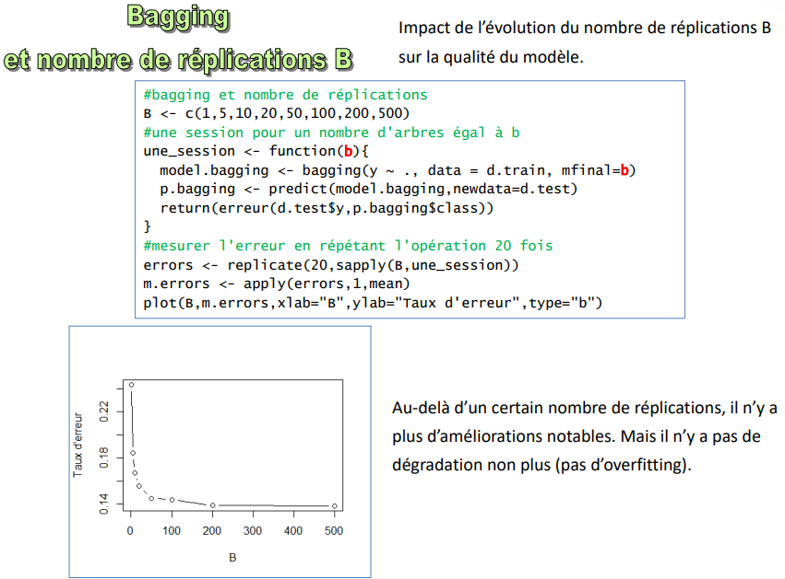
Bagging And Number of B Replications
Bagging
Impact of the evolution of the number of replications B on the quality of the model.
Beyond a certain number of replications, there are no more no more noticeable improvements. But there is no degradation either (no overfitting).

Slide 16
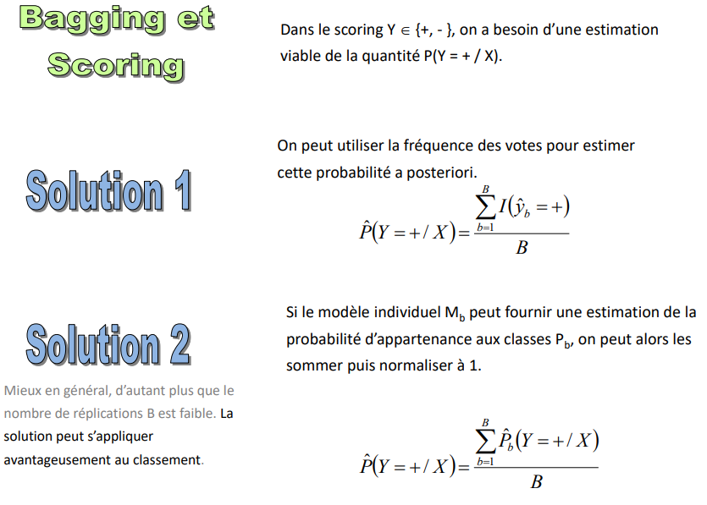
Bagging and Scoring
Bagging
In scoring Y € {+, - }, we need a viable estimate of the viable estimate of the quantity P(Y = + / X)
We can use the frequency of votes to estimate this probability this probability a posteriori
Solution 1
Solution 2
If the individual model Mb can provide an estimate of the probability of belonging to the classes Pb we can then summed and normalized to 1.
Better in general, especially as the number of number of B replications is low. The solution can be applied advantageously to the classification.

Slide 17
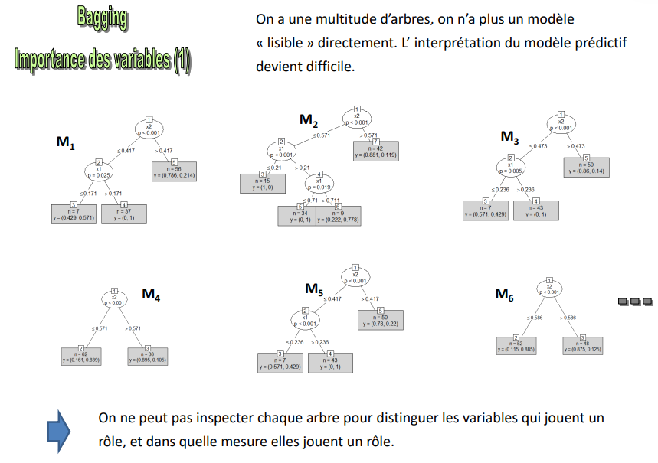
Bagging The importance of variables (1)
Bagging
We have a multitude of trees; we no longer have a model directly "readable". The interpretation of the predictive model becomes difficult.
We cannot inspect each tree to distinguish which variables play a role, and to what extent they play a and to what extent they play a role.

Slide 18
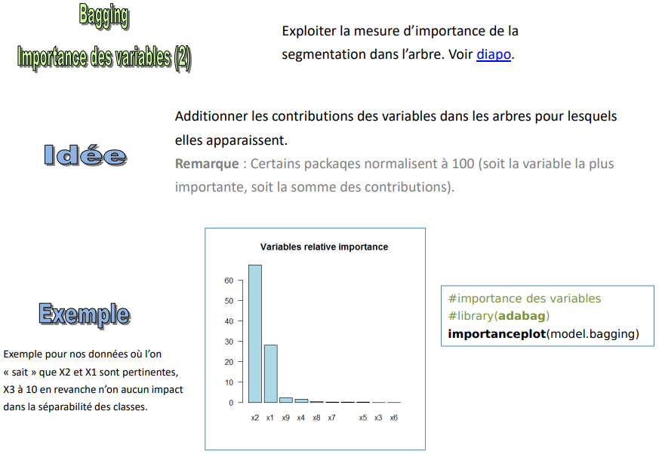
Bagging The importance of variables (2)
Bagging
Exploit the importance measure of the segmentation in the tree.
Add up the contributions of the variables in the trees for which they appear. they appear.
Note: Some packages normalize to 100 (either the most important variable or the or the sum of the contributions).
Idea
Example
#importance des variables
#library(adabag)
Importanceplot (modèle.bagging)
Example for our data where we "know" that X2 and X1 are relevant, X3 to 10 on the other hand have no impact in the separability of the classes.

Slide 19
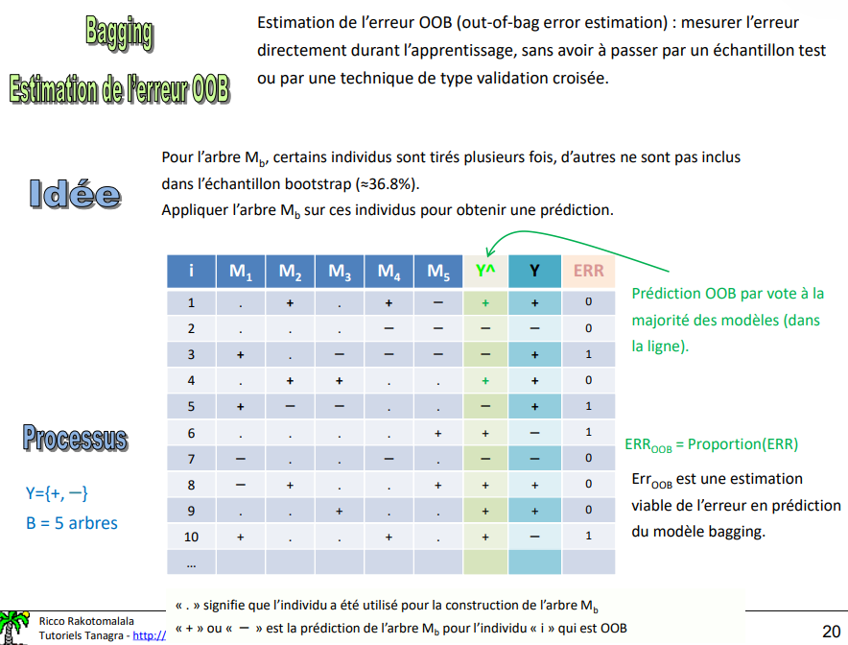
Bagging Error estimation OOB
Bagging
OOB (out-of-bag error estimation): measure the error directly during training, without having to go through a test sample or a cross-validation type technique.
Idea
For the tree Mb some individuals are drawn multiple times, others are not included in the bootstrap sample (≈36.8%). in the bootstrap sample (≈36.8%).
Applying the tree Mb on these individuals to obtain a prediction.
OOB prediction by voting on most of the models (in the line).
Process
ERROOB = Proportion(ERR)
ErrOOB is a viable estimate viable estimate of the error in prediction of the bagging model.

Slide 20
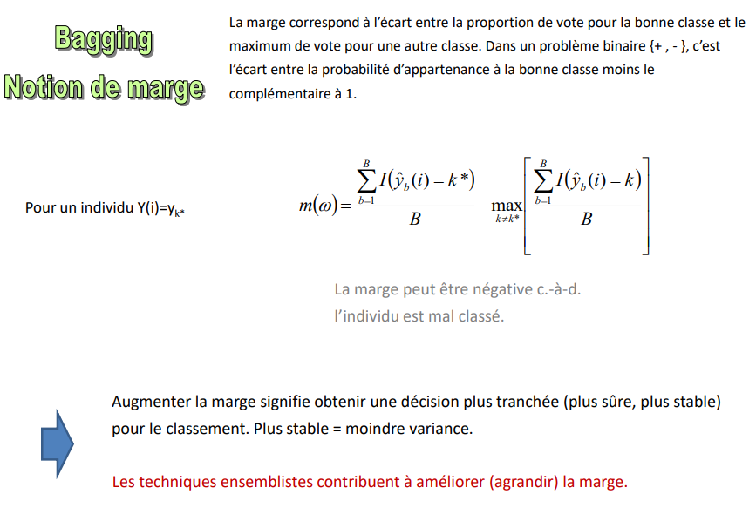
Bagging concept of margin
Bagging
The margin corresponds to the difference between the proportion of votes for the right class and the maximum of votes for another class. In a binary problem {+ , - }, it is the difference between the probability of belonging to the right class minus the complementary to 1.
For an individual Y(i)=yk*
The margin can be negative, i.e., the individual is misclassified.
Increasing the margin means getting a more clear-cut (safer, more stable) decision for the ranking. More stable = less variance.
Assembly techniques help to improve (increase) the margin.

Slide 21
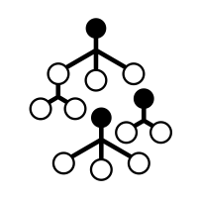
Random forest
Random Forest
Random forests (Breiman, 2001)

Slide 22
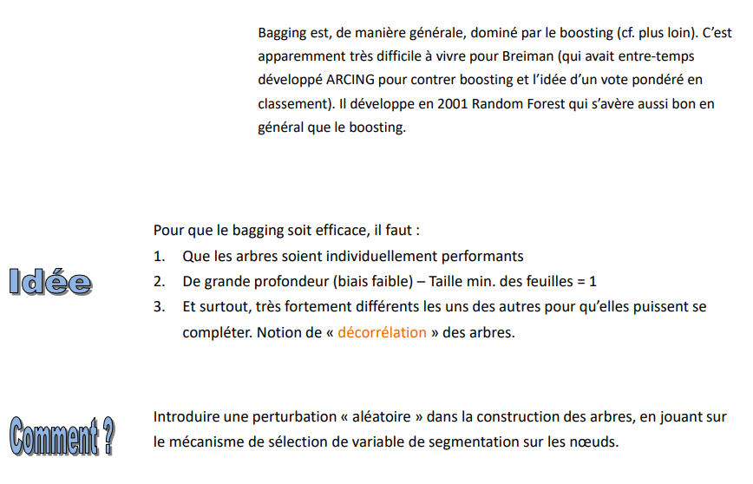
Random Forest starting point
Random Forest
Bagging is, in general, dominated by boosting (see below). This is apparently very difficult for Breiman (who in the meantime had developed ARCING to counter boosting and the idea of a weighted vote in ranking). In 2001 he developed Random Forest which turned out to be as good in general as boosting.
For bagging to be effective, you must:
1. That the trees are individually efficient
2. Deep (low bias) - Minimum leaf size = 1
3. And above all, very strongly different from each other so that they can complement each other. Notion of "decorrelation" of trees.
Idea
How?
Introduce a "random" perturbation in the construction of the trees, by playing on the selection mechanism of the segmentation variable on the nodes.

Slide 23
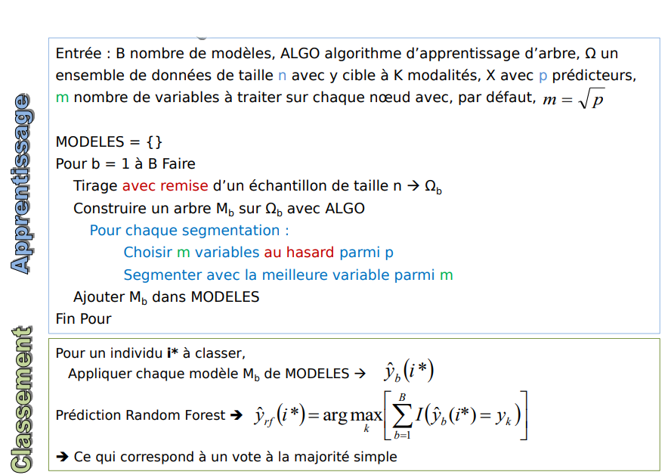
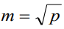
Random Forest Algorithm
Random Forest
Input: B number of models, ALGO tree learning algorithm, Ω a dataset of size n with y target with K modalities, X with p predictors, m number of variables to process on each node with, by default,
MODELS = {}
For b = 1 to B Do
Draw a sample of size n → Ω b with discounting.
Build a tree Mb on Ω b with ALGO
For each segmentation:
Choose m variables at random from p
Segment with the best variable among m
Add Mb in MODELS
End For
learning
For an individual i* to be classified,
Apply each model Mb of MODELS →
Bagging prediction ➔
➔ This corresponds to a simple majority vote
Classification

Slide 24
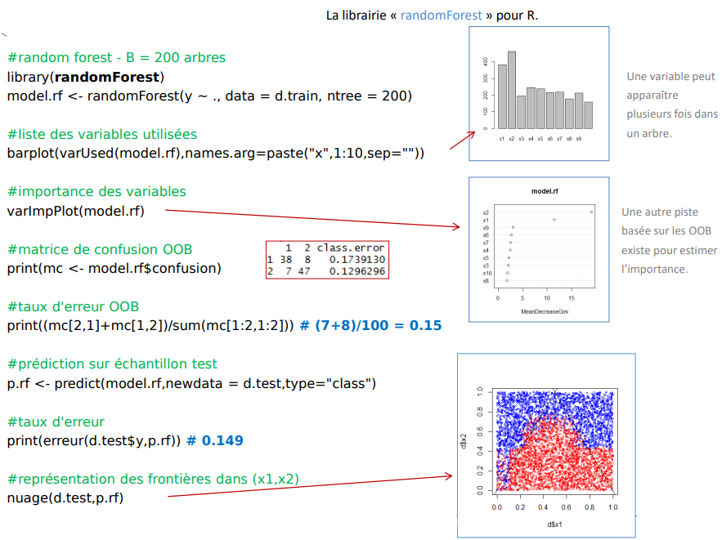
Random Forest In Practice
Random Forest
The "randomForest" library for R
#random forest - B = 200 trees
library(randomForest)
model.rf <- randomForest(y ~ ., data = d.train, ntree = 200)
A variable can appear several times in a tree.
#list of used variables
barplot(varUsed(model.rf),names.arg=paste("x",1:10,sep=""))
#importance of variables
varImpPlot(model.rf)
Another track based on the OOB exists to estimate importance.
#OOB confusion matrix
print(mc <- model.rf$confusion)
#OOB error rates
print((mc[2,1]+mc[1,2])/sum(mc[1:2,1:2])) # (7+8)/100 = 0.15
#prediction on test sample
p.rf <- predict(model.rf,newdata = d.test,type="class")
#error rate
print(error(d.test$y,p.rf)) # 0.149
#representation of the boundaries in (x1,x2)
cloud(d.test,p.rf)

Slide 25
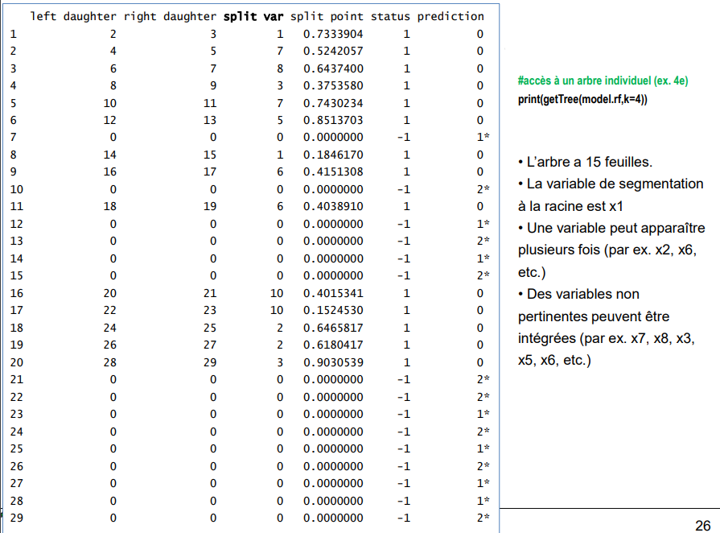
Random Forest Details on the trees
Random Forest
#access to an individual tree (e.g., 4e)
print(getTree(model.rf,k=4))
- The tree has 15 leaves.
- The segmentation variable at the root is x1
- A variable can appear several times (e.g., x2, x6, etc.)
- Irrelevant variables can be variables may be included (e.g., x7, x8, x3, etc.). included (e.g., x7, x8, x3, x5, x6, etc.)

Slide 26
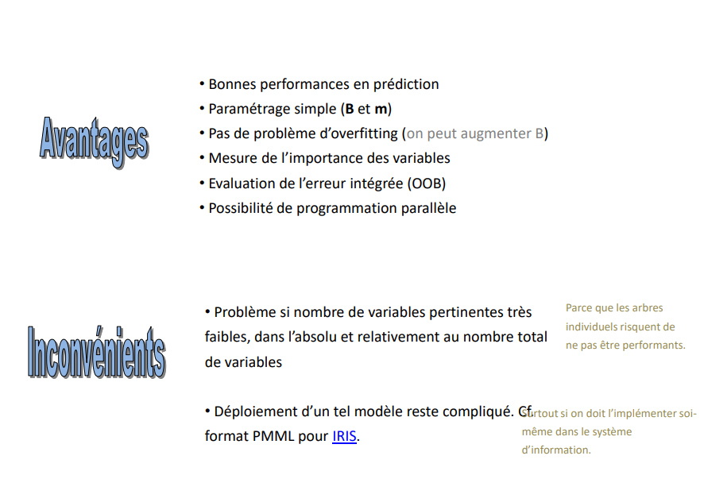
Random Forest balance sheet
Random Forest
- Good prediction performance
- Simple parameterization (B and m)
- No overfitting problem (we can increase B)
- Measurement of the importance of the variables
- Evaluation of the integrated error (OOB)
- Possibility of parallel programming
Pros
- Problem if the number of relevant variables is very small in absolute terms and relative to the total number of variables
Because individual trees individual trees may not perform well.
Cons
Deployment of such a model remains complicated.
especially if you must implement it yourself in the information system.

Slide 27
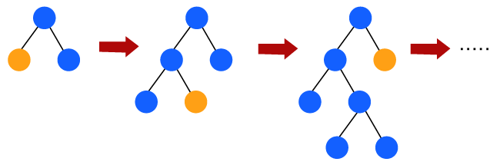
Boosting
Boosting
Freund & Schapire - ADABOOST (1996)

Slide 28
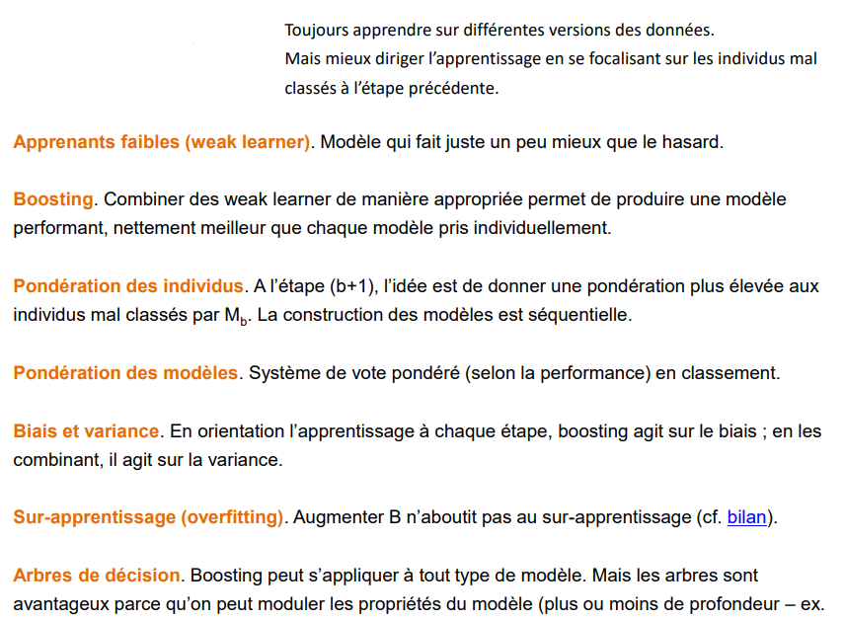
Boosting Ideas
Boosting
Always learn on different versions of the data. But better direct the learning by focusing on the misclassified individuals in the previous step.
Weak learners. Model that does just a little better than chance.
Boosting. Combining weak learners in an appropriate way produces a model that performs that is significantly better than each individual model.
Weighting of individuals. In step (b+1), the idea is to give a higher weight to the individuals poorly classified by Mb. The construction of the models is sequential.
Weighting of the models. Weighted voting system (according to the performance) in ranking.
Bias and variance. By orienting the learning at each step, boosting acts on the bias; by combining them, it acts on the variance.
Overlearning (overfitting). Boosting B does not lead to overlearning (see balance sheet).
Decision trees. Boosting can be applied to any type of model. But trees are advantageous because we can modulate the properties of the model (more or less depth - e.g., the number of trees in the model).

Slide 29
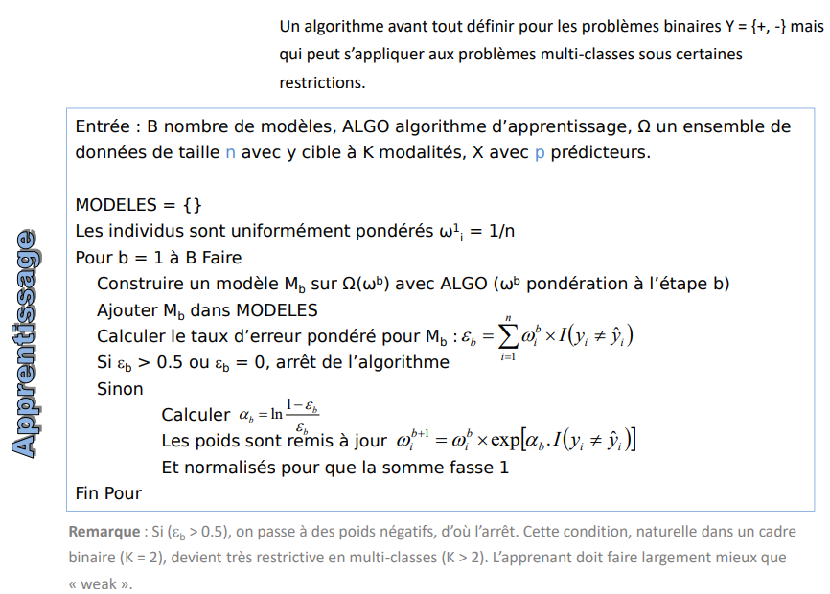
Adaboost.M1 Adaptive Boosting
Boosting
An algorithm primarily defined for binary problems Y = {+, -} but which can be applied to multi-class problems under certain restrictions.
Input: B number of models, ALGO learning algorithm, Ω a data set of size n with y target with K modalities, X with p predictors.
MODELS = {}
Individuals are uniformly weighted ωi = 1/n
For b = 1 to B Do
Build a model Mb on Ω(ωb) with ALGO (ωb weighted in step b)
Add Mb in MODELS
Compute the weighted error rate for Mb:
If εb > 0.5 or εb = 0, stop the algorithm
Otherwise
Calculate
The weights are updated
And normalized so that the sum is 1
End For
learning
Remark : If (b > 0.5), we switch to negative weights, hence the stop. This condition, natural in a binary framework (K = 2), becomes very restrictive in multi-class (K > 2). The learner must do much better than "weak".

Slide 30
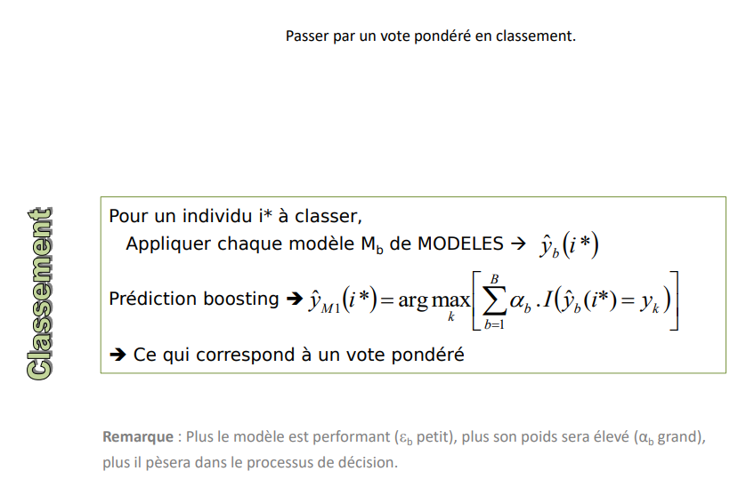
Adaboost.M1 Adaptive Boosting
Boosting
Go through a weighted vote in ranking
For an individual i* to be classified,
Apply each model Mb of MODELS →
Bagging prediction ➔
➔ This corresponds to a simple majority vote
Classification
Note: The better the model (εb small), the higher its weight (αb large), the more it will weigh in the decision process.

Slide 31
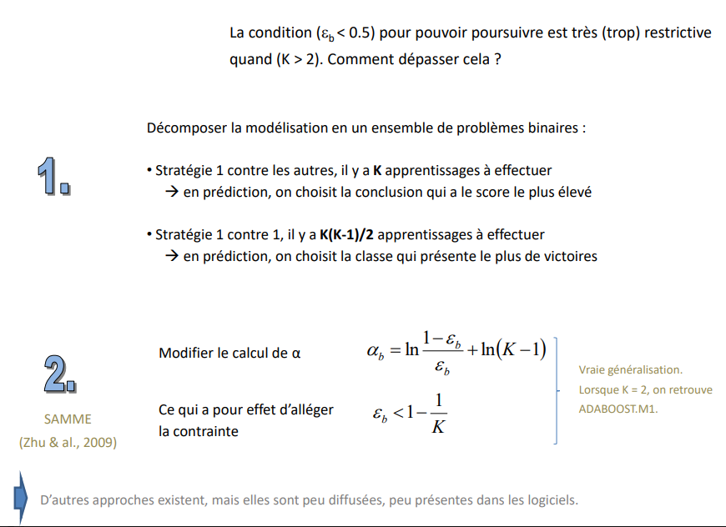
Boosting beyond the binary framework
Boosting
The condition (εb < 0.5) to be able to continue is very (too) restrictive when (K > 2). How to overcome this?
Break down the modelling into a set of binary problems:
- Strategy 1 vs. others, there are K learnings to be done → in prediction, we choose the conclusion with the highest score
- Strategy 1 vs. 1, there are K(K-1)/2 learnings to be performed → in prediction, we choose the class with the most wins
Modify the calculation of α
True generalization.
When K = 2, we find
ADABOOST.M1.
SAMME
(Zhu & al., 2009)
This has the effect of relieving the constraint
Other approaches exist, but they are not widely used, and not very present in the software.

Slide 32
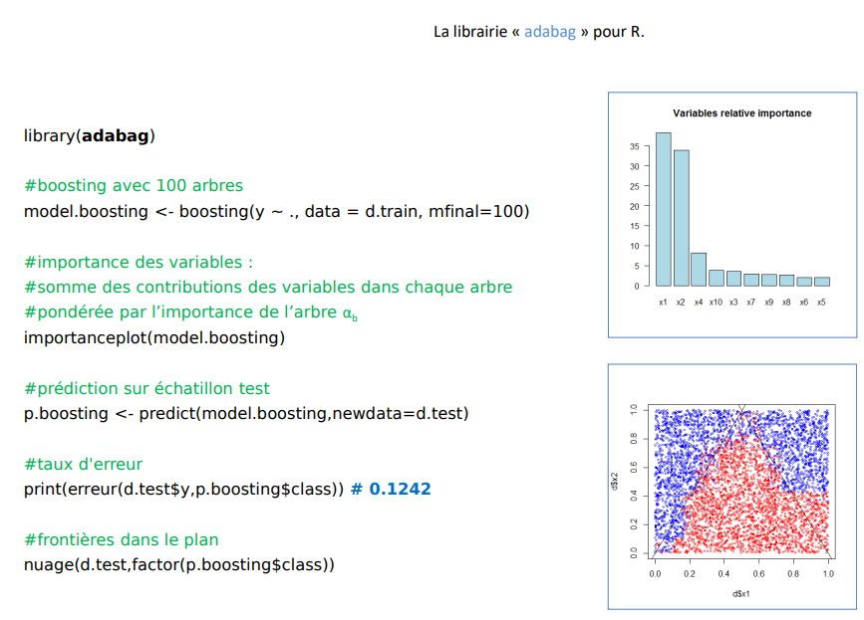
Boosting beyond the binary framework
Boosting
The bookshop "adabag" for R.
Library (adabag)
#boosting with 100 trees
model. Boosting <- boosting(y ~ ., data = d.train, mfinal=100)
#importance of variables :
#sum of the contributions of the variables in each tree
#weighted by the importance of the tree αb Importanceplot(model.Boosting)
#prediction on test sample
p.boosting <- predict(model.boosting,newdata=d.test)
#error rate
print(error(d.test$y,p.boosting$class)) # 0.1242
#borders in the plane
cloud(d.test,factor(p.boosting$class))

Slide 33
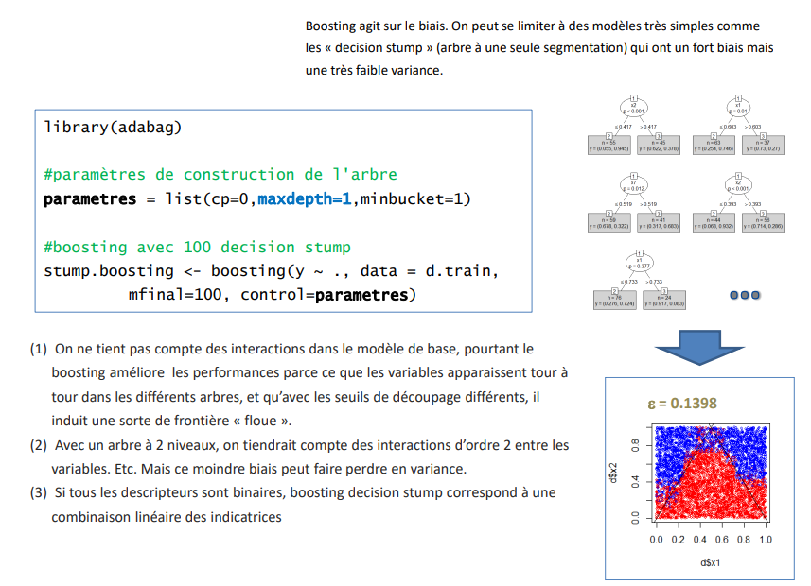
Boosting Decision Stump
Boosting
Boosting acts on the bias. We can limit ourselves to very simple models such as decision stump (tree with only one segmentation) which have a strong bias but a very low variance. a very low variance.
library(adabag)
#tree construction parameters
parameters = list(cp=0,maxdepth=1,minbucket=1)
#boosting with 100 stump decision
stump.boosting <- boosting(y ~ ., data = d.train, mfinal=100, control=parameters)
(1) Interactions are not considered in the basic model yet boosting improves the performance because the variables appear in turn in the different (1) We do not consider the interactions in the basic model but boosting improves the performance because the variables appear in turn in the different trees, and with the different cutting thresholds, it induces a sort of "fuzzy" border.
(2) With a 2-level tree, we would consider the second-order interactions between the variables. Etc. But this lesser bias can lead to a loss of variance.
(3) If all the descriptors are binary, boosting decision stump corresponds to a linear combination of

Slide 34
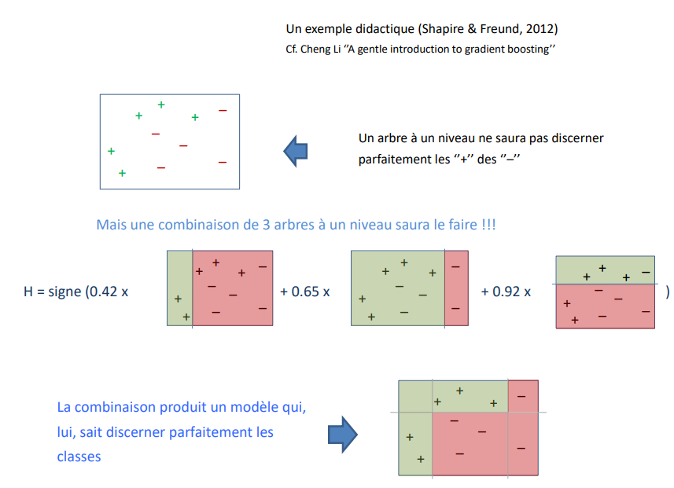
Boosting Decision Stump
Boosting
A didactic example (Shapire & Freund, 2012)
Cf. Cheng Li ''A gentle introduction to gradient boosting''
A one-level tree will not be able to discern
perfectly the ''+'' of the ''-''.
But a combination of 3 trees on one level will do it!!!
The combination produces a model that, can perfectly discern the classes

Slide 35
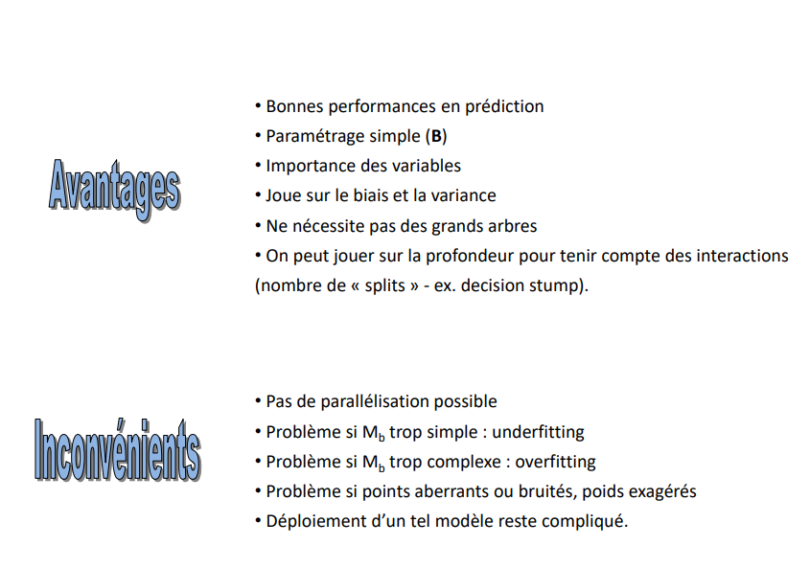
Boosting balance sheet
Boosting
- Good prediction performance
- Simple parameterization (B)
- Importance of variables
- Plays on the bias and variance
- Does not require large trees
- We can play on the depth to consider the interactions (number of splits - ex. decision stump).
Pros
- No parallelization possible
- Problem if Mb too simple : underfitting
- Problem if Mb too complex: overfitting
- Problem if outliers or noisy points, exaggerated weights
- Deployment of such a model remains complicated.
Cons

Slide 36

Software
Boosting

Slide 37
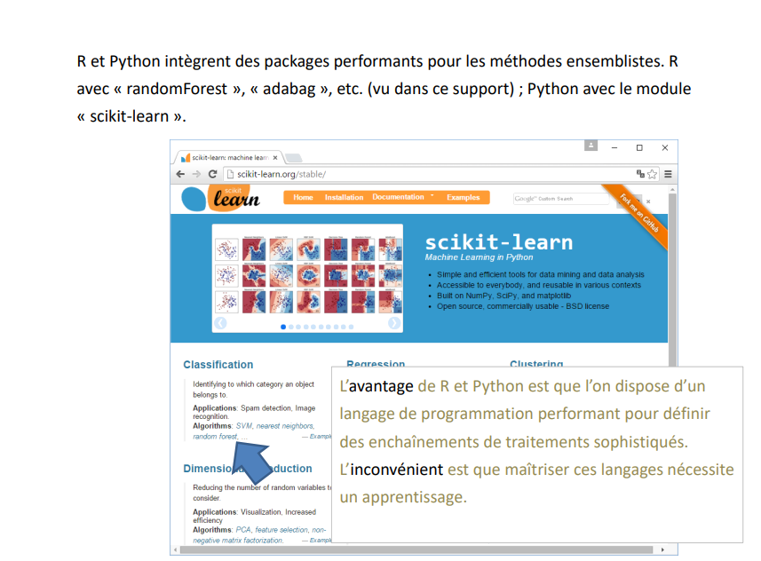
R & Python
Boosting
R and Python include powerful packages for set methods. R with "randomForest", "adabag", etc. (seen in this support); Python with the "scikit-learn" module.
The advantage of R and Python is that you have a powerful programming language to define sophisticated processing sequences. sophisticated processing sequences. The disadvantage is that mastering these languages requires an apprenticeship.

Slide 38
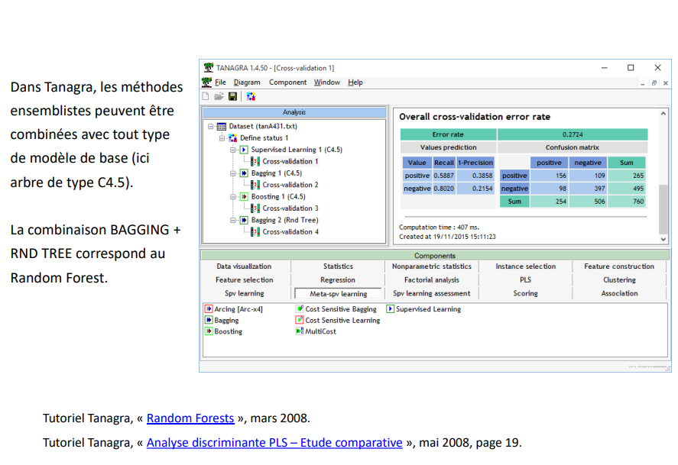
Tanagra
Boosting
In Tanagra, the set methods can be combined with any type of basic model (here tree type C4.5). methods can be combined with any type of basic model (here tree type C4.5).
The combination BAGGING + RND TREE corresponds to the Random Forest.
Tanagra Tutorial, "Random Forests", March 2008.
Tanagra Tutorial, "PLS Discriminant Analysis - Comparative Study", May 2008, page 19.

Slide 39
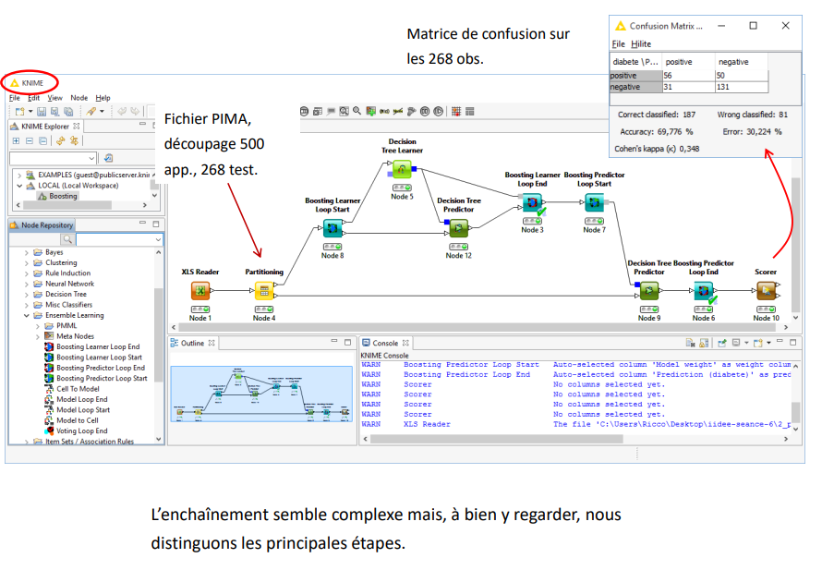
Knime, etc
Boosting
Confusion matrix on the 268 obs.
The sequence seems complex but, if we look closely, we can see the main distinguish the main steps.
In Tanagra, the set methods can be combined with any type of basic model (here tree type C4.5). methods can be combined with any type of basic model (here tree type C4.5).
The combination BAGGING + RND TREE corresponds to the Random Forest.

Slide 40
Knime, etc
Boosting
Confusion matrix on the 268 obs.
The sequence seems complex but, if we look closely, we can see the main distinguish the main steps.
In Tanagra, the set methods can be combined with any type of basic model (here tree type C4.5). methods can be combined with any type of basic model (here tree type C4.5).
The combination BAGGING + RND TREE corresponds to the Random Forest.

Slide 41

Balance Sheet
Boosting

Slide 42
Bagging, Random Forest, Boosting
Boosting
Set methods that repeatedly apply a learning method to different versions of the on different versions of the data (resampling, resampling, reweighting) are now well known, the performance gains are recognized.
The only real hindrance is the lack of readability of the meta-model, despite the "importance of variables" indicator, which prevents a sophisticated interpretation of cause-and-effect relationships, which is necessary in some areas.

